Slide 1
Lab 3: The Motors, Radio, Gimbals, LCD, buttons, knobs, and LEDs

Slide 2
Topics
Analog Inputs – How the microcontroller measure the position of the gimbals
Brushed Motors – How they work and how to drive them.

Slide 3
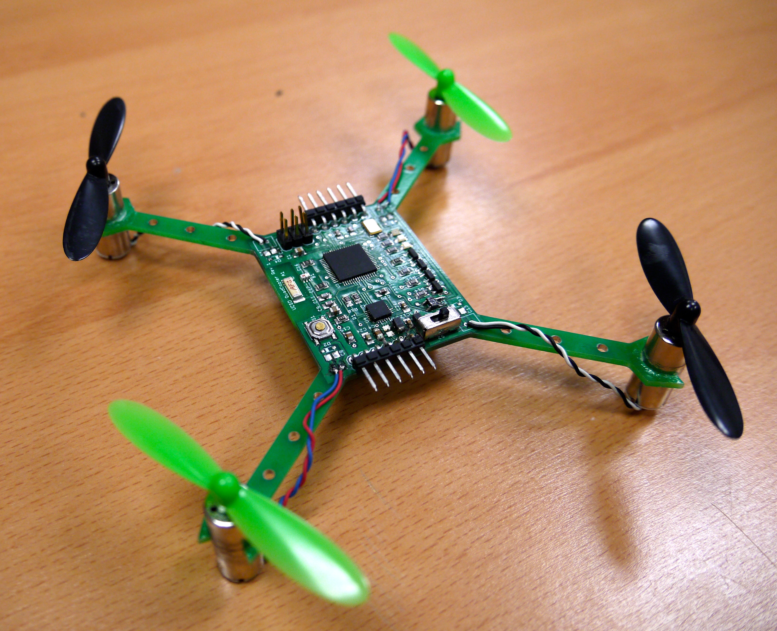
What You Will Build

Slide 4
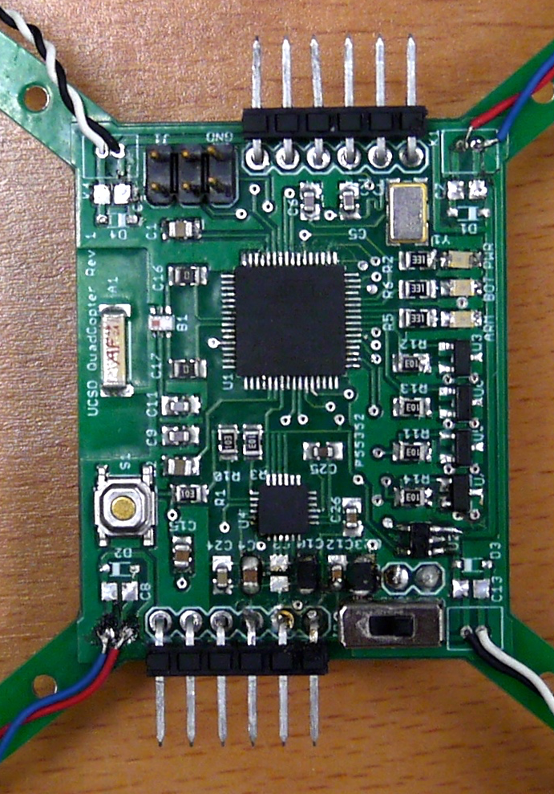
What You Will Build

Slide 5
Remote Control

Slide 6
Gimbals

Slide 7
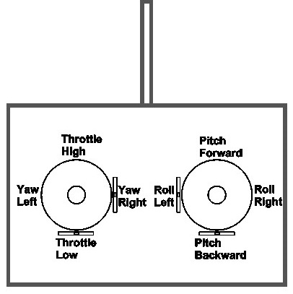
Controlling the Quadcopter
Standard RC “transmitters” have two sticks
Left: throttle and yaw
Right: pitch and roll
This is called “mode 2” It’s different in Europe where they use “mode 1”
Yaw, pitch, and roll are spring-loaded to return to neutral
Throttle stays where you put it.

Slide 8
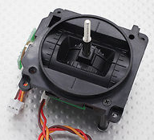
The Gimbals
Each stick is a “gimbal”
a mechanism, typically consisting of rings pivoted at right angles, for keeping an instrument such as a compass or chronometer horizontal in a moving vessel or aircraft. – The dictionary on my Mac

Slide 9
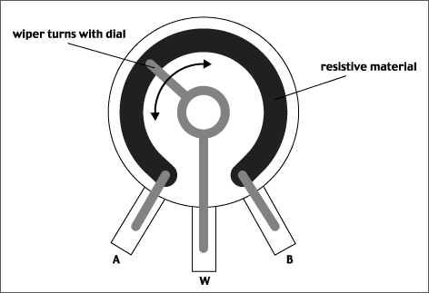
Anatomy of a Gimbal
Two potentiometers measure X and Y movement of the stick.
Potentiometer – A variable voltage divider
As the slider moves, the resistances between A and W and W and B change.
If A is at Vcc and B is at GND, then the voltage at W is proportional to the position of the gimbal.

Slide 10
Measuring the Gimbals
You need the analogread() function in arduino.
https://www.arduino.cc/en/Reference/AnalogRead

Slide 11
Other Remote Components

Slide 12
Status LEDs
The remote has 3 status LEDs (D3, D4, D5) in the upper left of the control board.
They are useful for letting you know when the quad is armed, etc.
Use digital_write() to control them.

Slide 13
Buttons
The remote has 2 buttons (B1, B2) for your use.
Use digital_read() to see if they are pressed.

Slide 14
Pots
The remote has 2 potentiometers (TM1, TM2)
Use analog_read() to get their value.

Slide 15
LCD
Display text and status information.

Slide 16
Brushed DC Motors

Slide 17
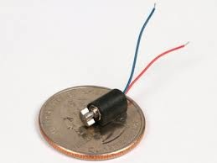
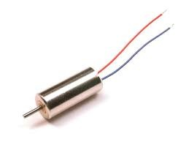
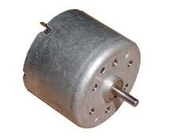
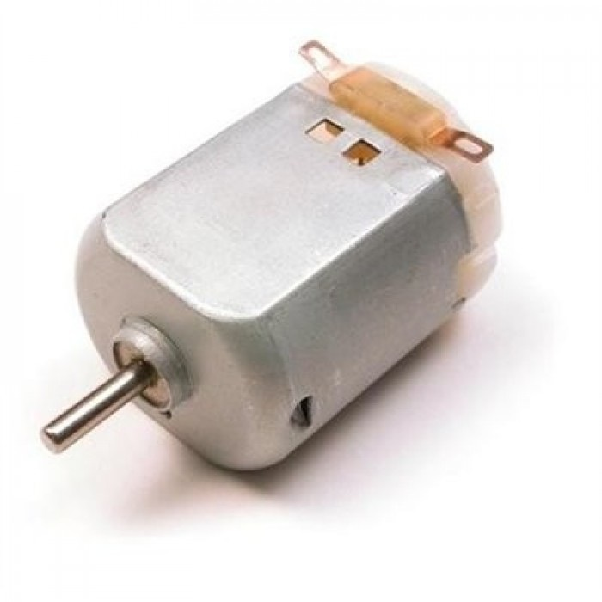
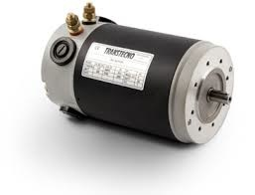
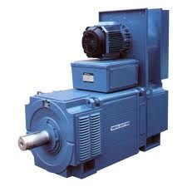
Brushed Motors

Slide 18
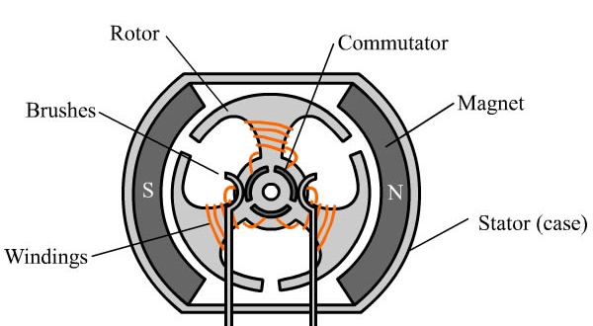
Construction

Slide 19
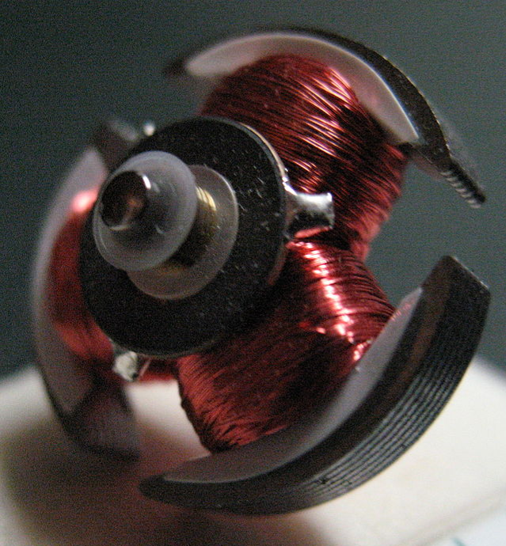
Construction (Rotor)

Slide 20
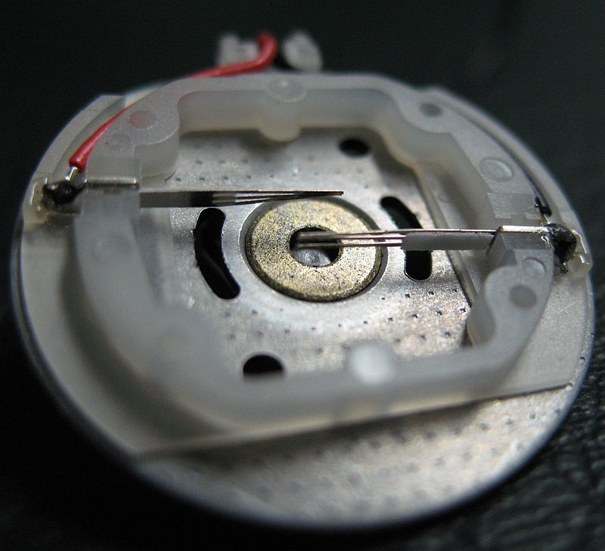
Construction (Stator)

Slide 21
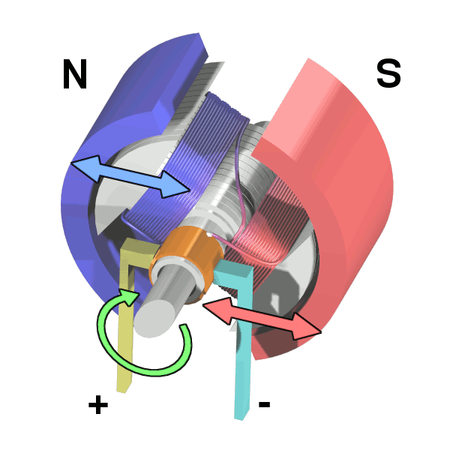
Operation

Slide 22
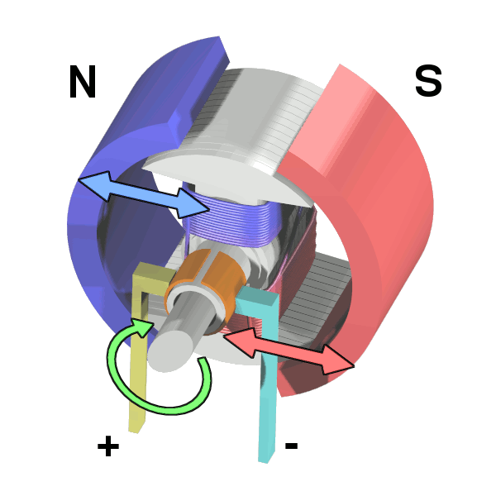
Operation

Slide 23
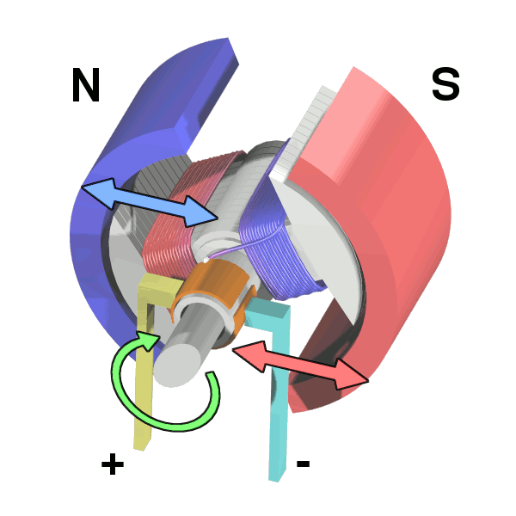
Operation

Slide 24
Operation

Slide 25
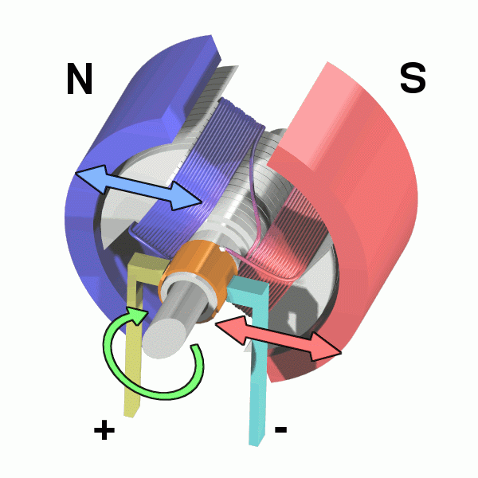
Operation

Slide 26
Control
How would you control your motor’s speed?
Speed ∝Voltage ∝Current
So, vary the input voltage
Generating varying voltages is non-trivial
You need an digital-to-analog converter
Really, we just need the average voltage to vary

Slide 27
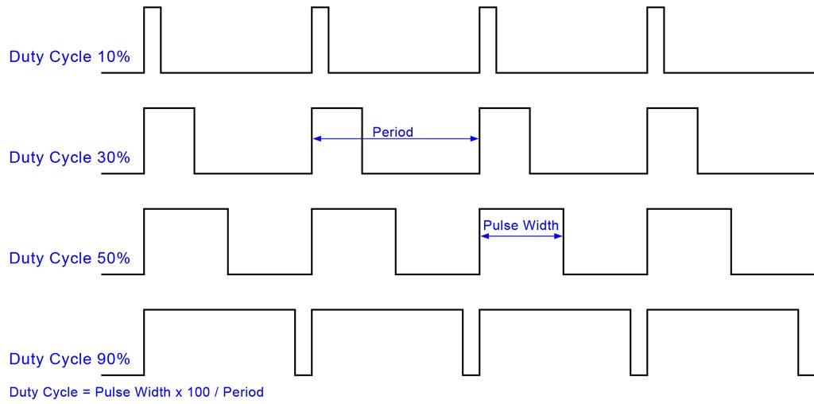
Pulse-width Modulation (PWM)

Slide 28
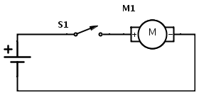
Flyback
When S1 is open after the motor has been running, M1 becomes a big inductor
It will drive up the voltage on GND
Potentially damaging/interfering with other parts of the circuit
This is called “fly back”

Slide 29
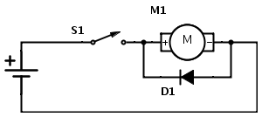
Flyback Diode
Adding a diode, allows the current to loop around through the motor and eventually dissipate

Slide 30
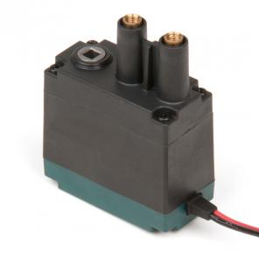
Selection
Free Speed:100 rpm
Stall Torque:8.6 in-lbs
Stall Current:2.6A
Free Current:0.18A
Specifications at 7.2V

Slide 31
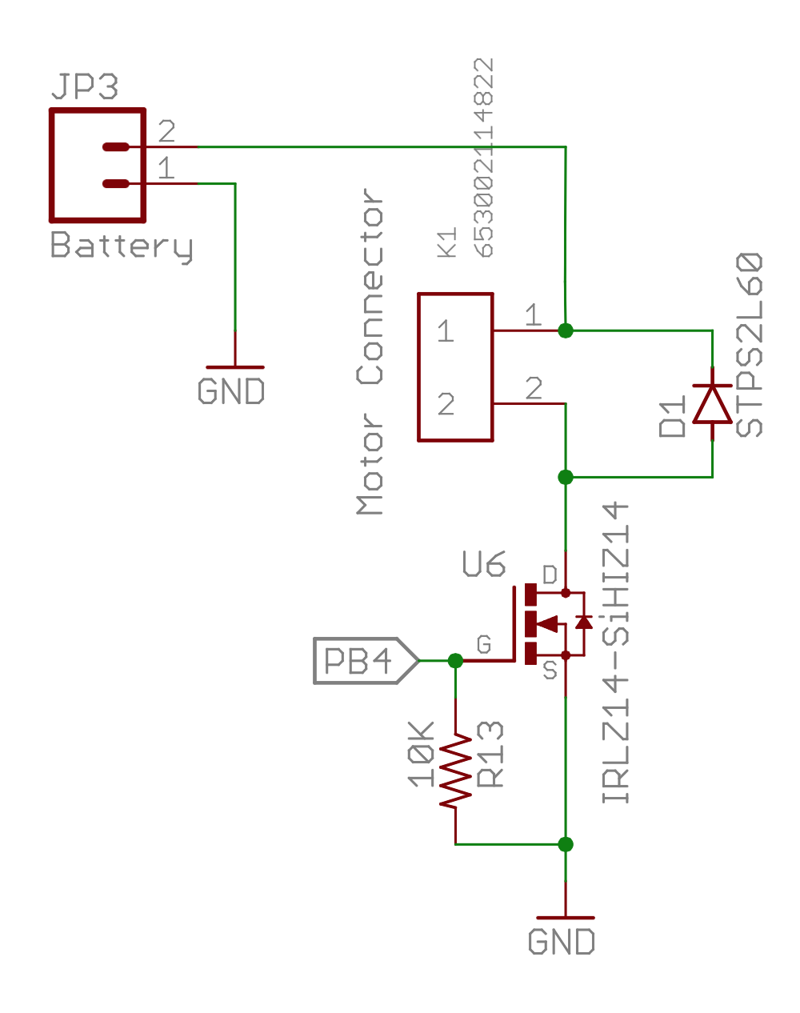
Our Motor Circuits

Slide 32
Analog IO in Arduino
The red board board has several analog pins
analogRead()
Takes a voltage between GND and Vcc and maps it to 0—1024
analogWrite ()
Takes a value, x, between 0 (off) and 255 (on) and sets the duty cycle to x/255.

Slide 33
Test Stand

